Slide 1

[Title of Document]
[Date]
Executive Summary
The [Museum Name] is wrapping up another successful year, having seen overall growth across our operations. While we are a vital part of the local tourism economy – and most of the people who drop in to see exhibits are visitors from out of town – our programs and activities continue to focus on supporting the community. [Percentage] of our visitation/participation comes from [Name of Community]. We have expanded our programming and seen a very high level of repeat attendance from local participants.
We have noticed a significant increase in the number of services people access during a single visit, and a commensurate increase in the length of time visitors spend at the Museum. While this clearly demonstrates the value of our collections, exhibits, and range of programming, it places a significant burden on our staff.
We are looking ahead to a range of exciting initiatives: [high-level list of plans for the coming year]
Staffing represents one of our greatest challenges. Our permanent staff consists of [list job titles]. Normally, we supplement this with [number] seasonal staff members. This year, due to budget cutbacks and massive oversubscription of the funding programs that enable us to hire seasonal staff, we were only able to hire [number] seasonal employees. As visitation and demand for our programs and services increases, this downward trend in staff funding will put increasingly significant pressure on our budget and operations.
We excel at stretching our limited budget and finding creative solutions to financial constraints. However, our two largest budget items – salaries and facilities costs – are subject to inflationary pressures well above the overall CPI and our core operating funding has not kept pace. As a result, we are forecasting a growing annual deficit that will deplete our reserves in only a few years. This is one factor behind our efforts to build earned revenues and corporate/foundation donations over the next few years.
In addition to addressing the higher-than-CPI inflationary pressures, we recognize a need for additional staff to support the ever-growing demand for our programs and services.
We are requesting an increase in core funding from [Name of Funder] of [Amount Requested], based on the following:
Increase to address shortfall compared to cumulative CPI increases since [Year]: [Amount Requested]
Increase to help address rising facilities operating costs in excess of CPI: [Amount Requested]
Increase to support incremental costs of moving from a part-time to full-time position: [Amount Requested]
[Museum purpose statement]

Slide 2
[Year] in Review
[Title of Document]
[Number]
visitors from all over the world – we’re an integral part of the local tourism economy
[Percentage]
Local participation across all programs - we are deeply integrated in the community
“[Quote]”
- Museum visitor from [Location]
“[Quote]”
- Participant in [Name of Program]
[Number]
research requests – we connect people to their family’s stories and to the community.
[Number]
community partners and organizations – we’re supporting their activities and benefiting an unseen audience of thousands.
“[Quote]”
Museum visitor learning [what they learned].
“[Quote]”
- [Person/role and connection]
Beyond the Numbers
Planning and Governance:
We have completed a strategic planning process to guide us through the next three years. Increasing repeat visitation and in visitors accessing multiple services emphasizes our value but raises logistical challenges.
Collections:
Over [Number] individual donations, comprising [Number] objects, photographs, and documents, received this year. We’re working hard to digitize and expand the collections information we share on [List of websites and social media platforms]
Exhibits:
We worked with community partners to complete the [Title of Exhibit] exhibit at the [Location]. We’re developing a new exhibit, [Title of Exhibit] for the Museum next summer.
Programs:
We’ve maintained our very successful [Name/Type of Program] programming and added [Name of program/service] to our roster. Our programs are also expanding to include [Name of new program] beginning in [month/date].

Slide 3
Current Financial Position
[Title of Document]
Full-Time-Equivalent Staff
[Lead Staff Title] [1.0]
[Job Title] [Time]
[Job Title] [Time]
[Sum]
An average of [No.] volunteers
contribute [No.] hours per month
We are achieving all our work with the equivalent of only [Number] full-time staff members.
Our budget is balanced but we are forecasting a growing annual deficit that will eventually deplete our reserves. We are working to build earned revenues and donations.
Federal Grants
Donations
Other grants reflect staff capacity to undertake collections, programming, and collections projects. General
stagnant trend in external staffing grants represents a significant challenge to our capacity as minimum wage increases.
Our two largest budget expenses are subject to inflationary pressures that significantly exceed average CPI.

Slide 4




Looking Forward
[Title of Document]
Collections,
Programs,
Exhibits
Facilities and
Accessibility
2026-2027: Replace [old equipment and/or aging building elements].
2027: Submit funding application to improve public accessibility and functionality as a rental space for seniors’ groups, Museum activities, and other community needs.
2027: Addition of [building element – ie ramp, rail etc] to improve accessibility.
Ongoing: Monthly contributions to [Facility Reserve Fund] to support anticipated major repairs and upgrades as infrastructure ages.
2026-2027: New exhibit, [Title of Exhibit] in collaboration [Partner Organization(s)].
2026-2027: Digitization of [Theme/Collection] and sharing via [Online Platforms].
2027: Project to collect oral histories and research [Theme/Subject] – funding application in progress.
2027: Review and redevelopment of school programming.
Human
Resources
Financial Resources
and Sustainability
Ongoing: Expand volunteer recruitment and volunteer-based partnerships with other community organizations to involve more volunteers in day-to-day programs and services and free up staff for curatorial, planning, and development tasks.
2026: Establish a full-time [job title] to take the lead on [roles/tasks] – funding pending.
2026-2032: Establish a leadership Succession Plan ahead of current [job title]’s anticipated retirement.
2026-2027: Implementing new policies, booking systems, and promotions to increasing revenue from [building/program/service].
2026-2027: Revisiting admission and research fee structure and policies to increase Earned Revenues while maintaining broad affordability and accessibility.
2027: Increased budget for Gift Shop inventory to generate additional revenues while provide an outlet for local artists, producers, and authors
Ongoing: Building relationships with corporate, foundation, and private donors to build sustainable Sponsorship Revenues.

Slide 5
Overview: [Job Title]
[Title of Document]
[This section is a proposal for funding to support a new position. Consider what additional support could do to benefit your museum and community and adjust the following sections accordingly.]
The [Job Title] is a full-time position responsible for all visitor-facing activities and related administrative tasks: Visitor Services; Volunteer and Membership Support; Personnel Management; and
administrative and collections management tasks related to these areas of responsibility.
Under its current staffing model, the [Name of Museum] has reached the absolute limits of its capacity: we can neither expand our connection and role in the community, nor sustain what we are already attempting. Increasingly, our [FTE number from page 3] FTE team faces burnout and limited operational resilience in the event of illness, vacations, or special projects.
A strategic investment
that will yield
measurable benefits in
operational stability, community impact, and financial resilience.
A [number – second, third, etc.] full-time employee enables the [Name of Museum] to realize its potential as a dynamic cultural and educational hub for the community:
Expand programs, events, and outreach
Develop and deliver exhibits and educational offerings that attract new audiences
Pursue grants, sponsorships, and partnerships that require staff capacity to manage
Ensure consistent coverage for public hours, special events, and administrative duties, reducing disruptions in operations.
Provide succession and continuity planning, crucial in an organization where knowledge, contacts, and processes are concentrated almost entirely in one individual.
Provide an opportunity to train and coordinate volunteers as a backup workforce for the museum.
Build capacity for growth and revenue generation
Increased Capacity Outcomes
10-15%
Projected growth in admission, gift shop, donations revenues per year due to the [Job Title}’s ability to expand programming, opening hours, and outreach
20-25%
Anticipated increase per year in volunteer hours because the [Job Title] can devote more time to recruiting, training, and supporting them.
10%
Projected growth in membership revenues due to the [Job Title] ’s focus on member engagement and retention
+2
Major exhibit and collections projects per year undertaken by the Curator, resulting in increased visitation and consequently increased admission and donation revenues
+1
Minimum number of new project grant, operating grant, or corporate/foundation sponsorship targeted per year – a role the Curator now has time to take on

Slide 6
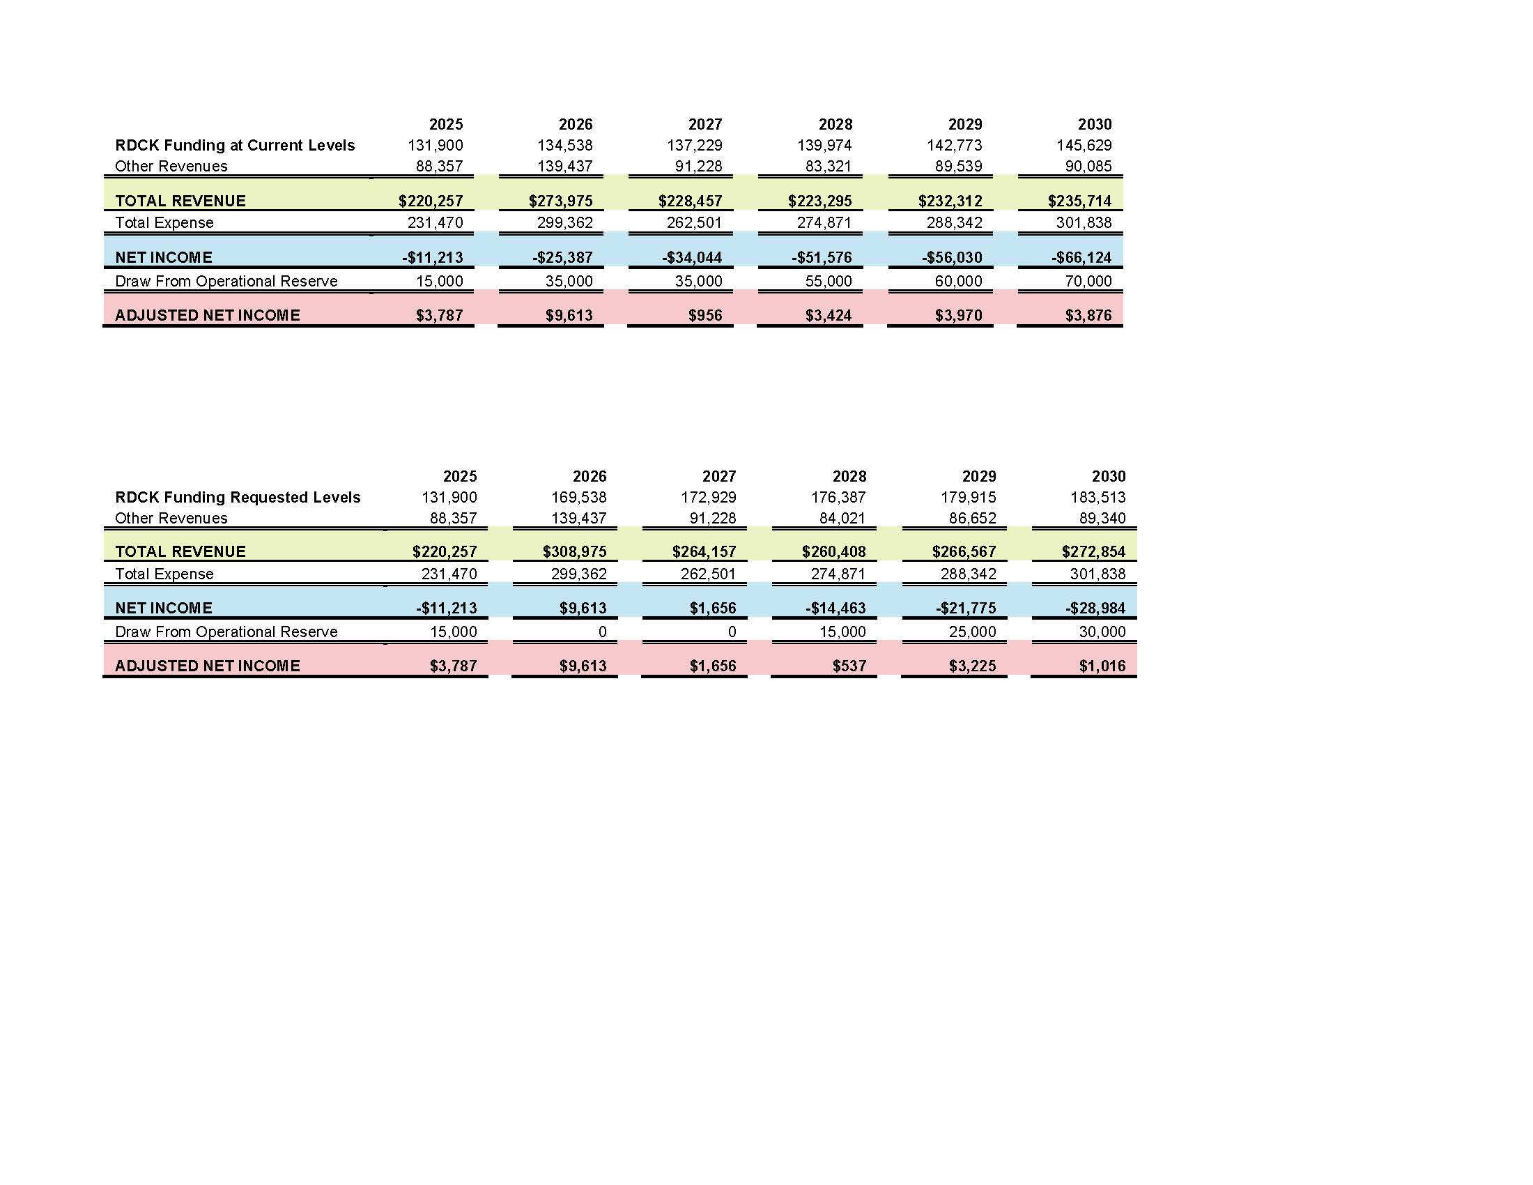
Projected Financial Position
[Title of Document]
[This section continues with the proposal for a new staff position. Consider what additional support could do to benefit your museum and community and adjust the following information accordingly.]
Financial Impacts of the [Job Title] Position
$[Number]
Proposed 2026 salary of new full-time Operations Manager role,
including mandatory related costs
+$[Number]
Annual cost of benefits for full-time Operations Manager: extended health, and annual professional development support
-$[Number]
Annual cost of current part-time Museum Assistant position,
including salary and mandatory related costs
$[Number]
Incremental budget impact of changing the current part-time position to a full-time one
The table above provides a five-year budget summary, including the incremental cost of creating a second full-time position, but without any additional increase in [name of program] funding. Note these projections require significant annual drawdowns from our operational reserve and will exhaust the reserve completely by early in 2031. Please see Appendix A – Budget Projections at Current Funding Levels for details.
Funding Increase Requested
$[Number]
Increase to address shortfall compared to cumulative CPI increases since 2019
$[Number]
Increase to help address rising facilities operating costs in excess of CPI
$[Number]
Increase to support incremental costs of moving from a part-time to full-time position
$[Number]
Total increase requested
The table above provides five-year budget projections, including the incremental cost of creating a second full-time position, with the requested increase in RDCK funding. Please see Appendix B – Budget Projections at Requested Funding Levels for details.

Slide 7
Appendix A:
Budget Projections at Current Funding Level
[Title of Document]

Slide 8
Appendix B:
Budget Projections at Requested Funding Level
[Title of Document]

